Slide 1
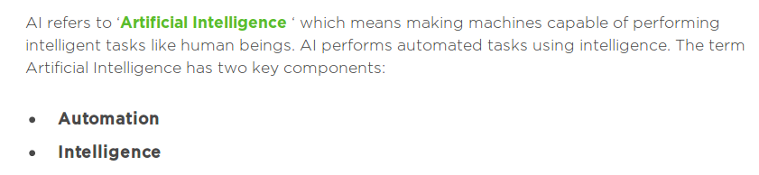
What is AI?

Slide 2
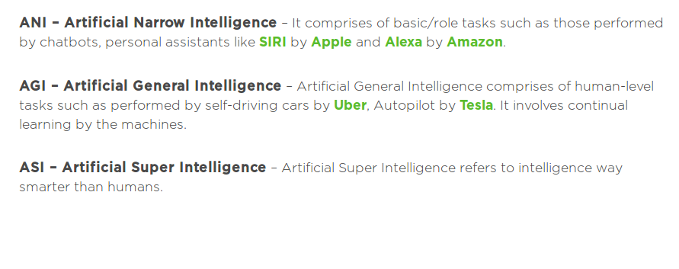
Types of AI

Slide 3
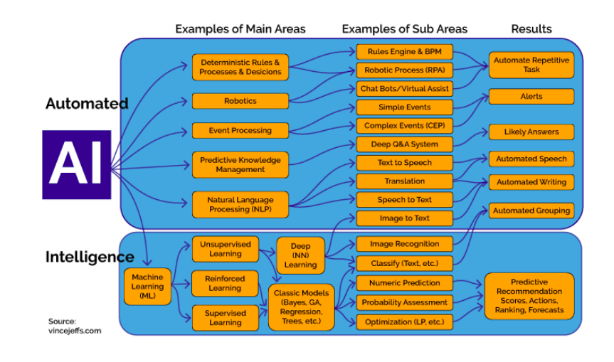
AI: Scope

Slide 4
Big Data?
Big data is everything quantified and tracked .
    ---Dr. Krik Brone (Principal Data Scientist)

Slide 5
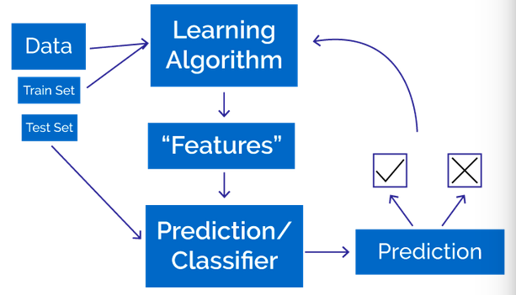
Machine Learning

